Slide 1
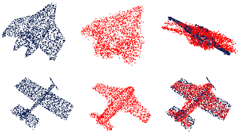

Robust Point Cloud Perception
Nahyuk Lee$^{1}$ Minkyu Kim$^{2}$ Hayun Lee$^{1}$
School of CSE, Chung-Ang Univ.$^{1}$
School of EE, Chung-Ang Univ.$^{2}$

Slide 2
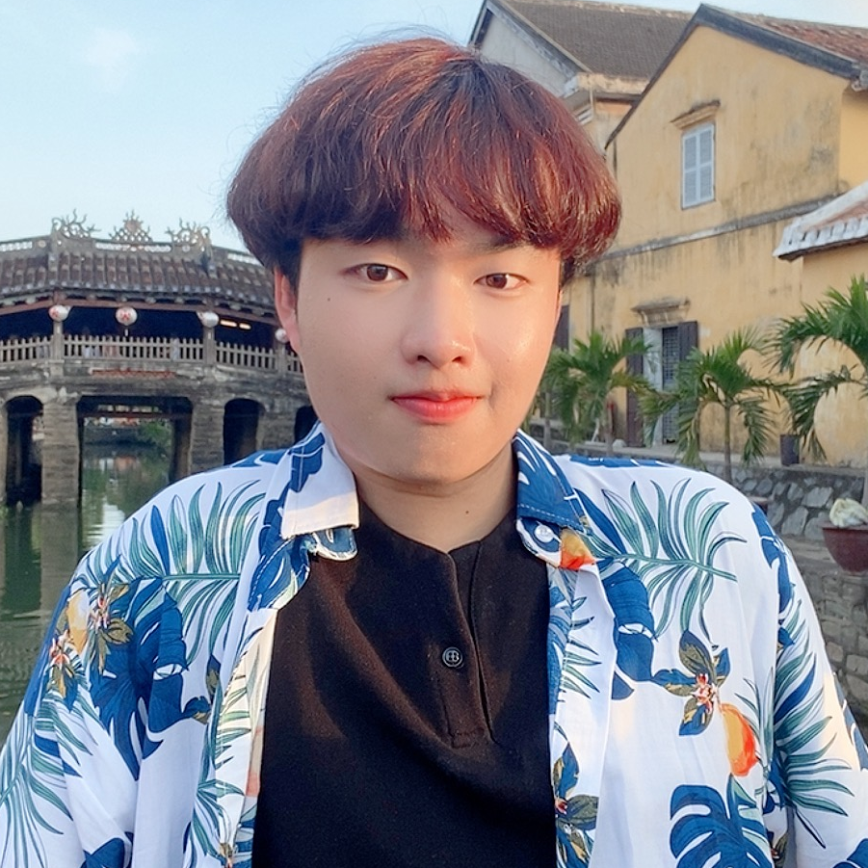
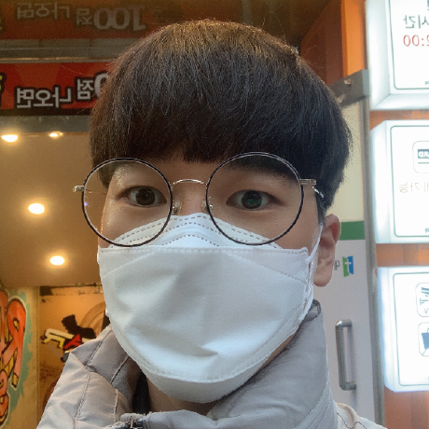

Our Team
Nahyuk Lee
3D Computer Vision
-
Incoming Graduate Student
@ CV Lab, POSTECH CSE
Minkyu Lee
Signal Processing (Audio&Image)
-
Research Intern
@ AMI Lab, POSTECH EE
Hayun Lee
Machine Learning
-
Research Engineer
@ Laivdata

Slide 3
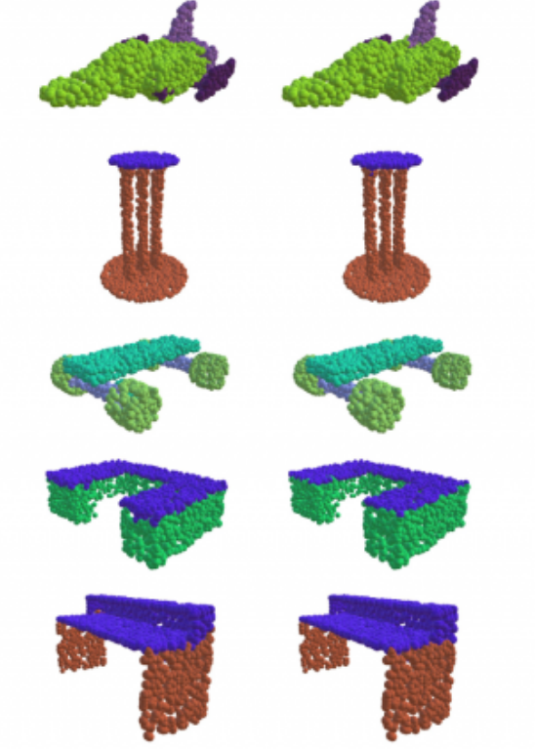
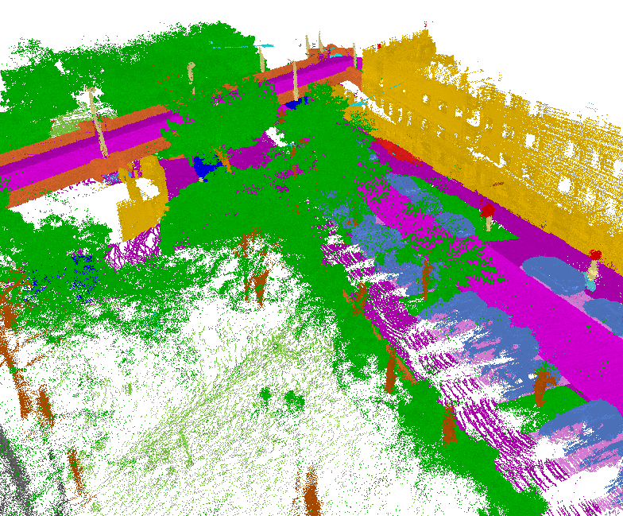
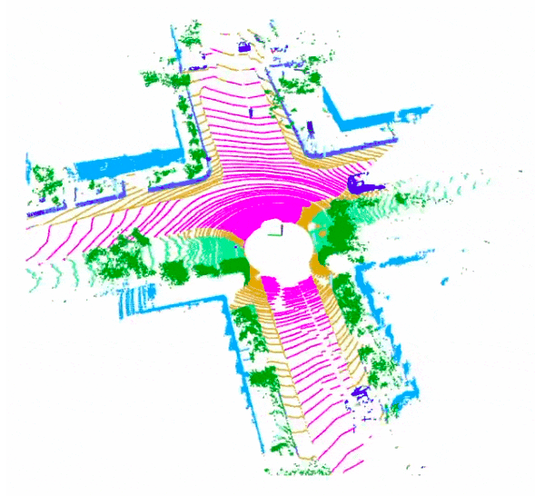
Introduction
Some types of 3D Point Clouds
Object Scale
Scene Scale
LiDAR

Slide 4
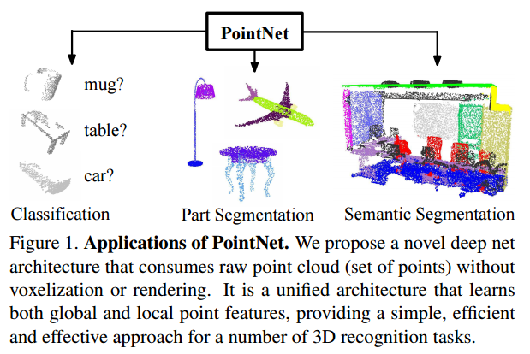
Introduction
3D Point Clouds Perception

Slide 5
Introduction
3D Point Clouds Perception
Focusing

Slide 6
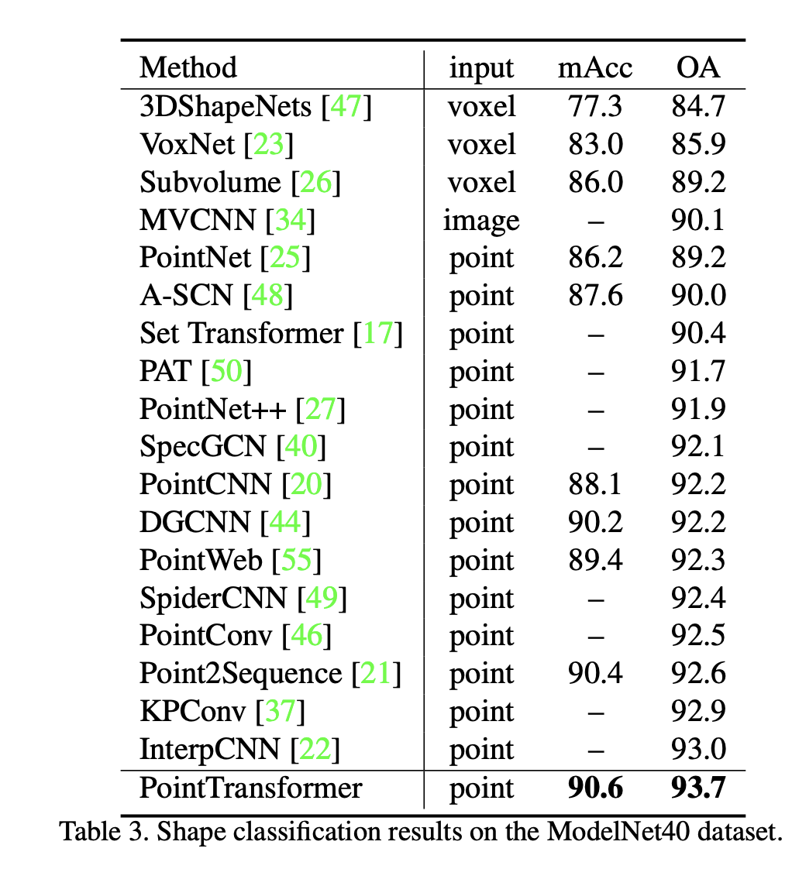

Introduction
3D Point Clouds Perception
ModelNet40 Classification Result
High Performance after appearance of PointNet

Slide 7
Introduction
3D Point Clouds Perception
ModelNet40 Classification Result
BUT
High Performance after appearance of PointNet

Slide 8
Problems
Fairness
ModelNet40 Classification Result
All of these models equally sampled?

Slide 9
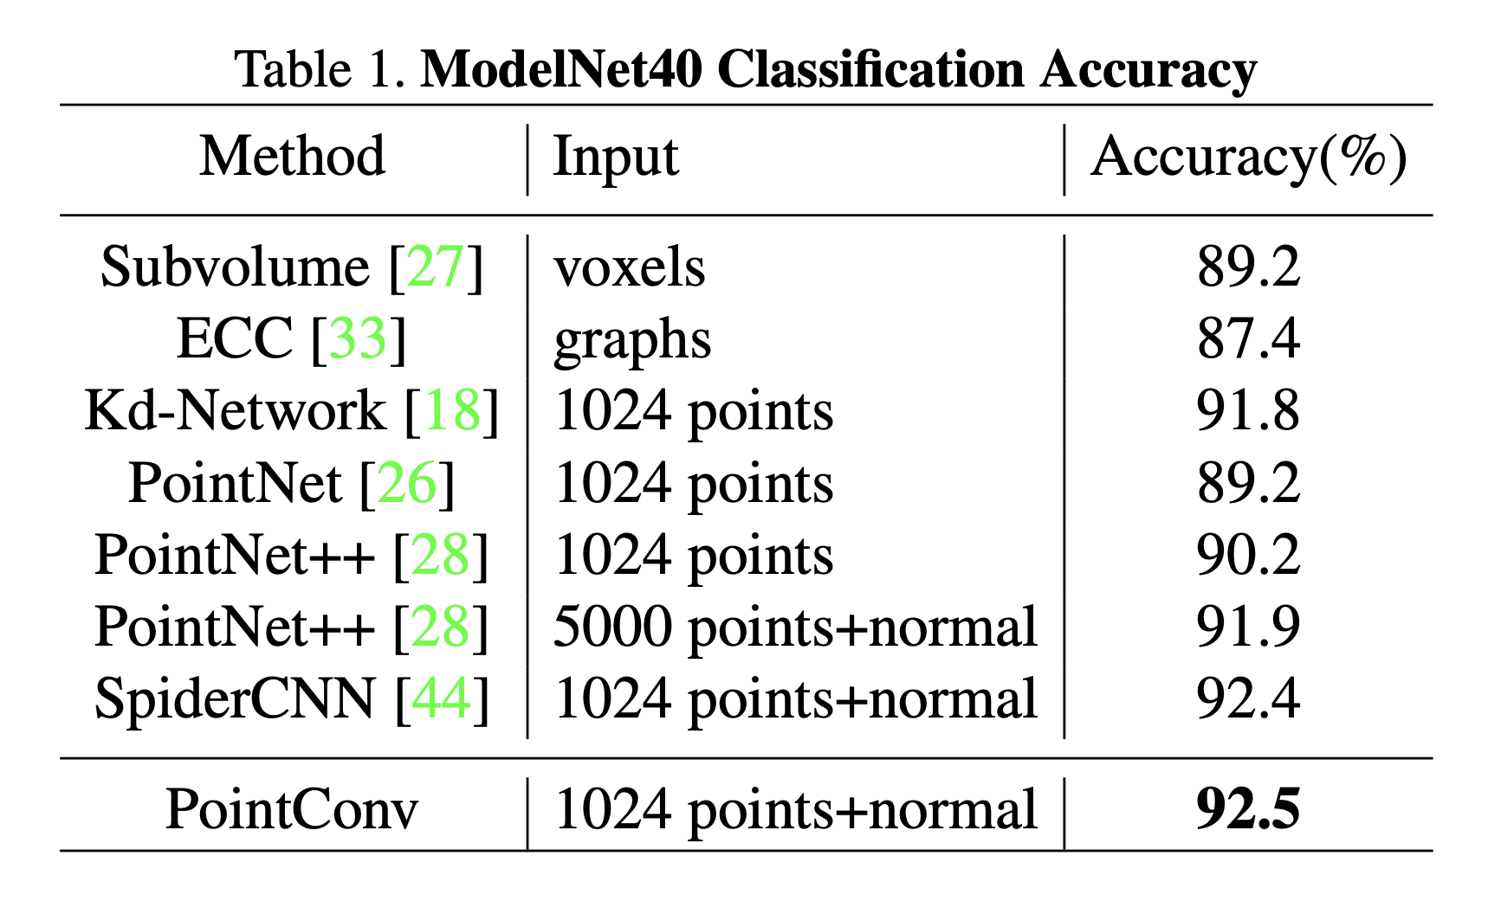
Problems
Fairness
ModelNet40 Classification Result
All of these models equally sampled?
No.

Slide 10
Problems
Fairness
ModelNet40 Classification Result
All of these models equally sampled?
No.
All of these models using normal for training?

Slide 11
Problems
Fairness
ModelNet40 Classification Result
All of these models equally sampled?
No.
All of these models using normal for training?
No.

Slide 12
Proposal
Fairness
Re-rank existing SOTA models for Point Clouds Classification

Slide 13
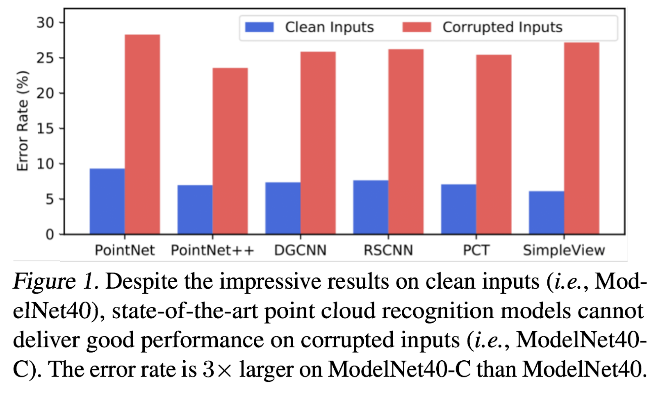
Proposal
Robustness
Re-rank existing SOTA models for Point Clouds Classification
Testing robustness of SOTA models with ModelNet40-C

Slide 14
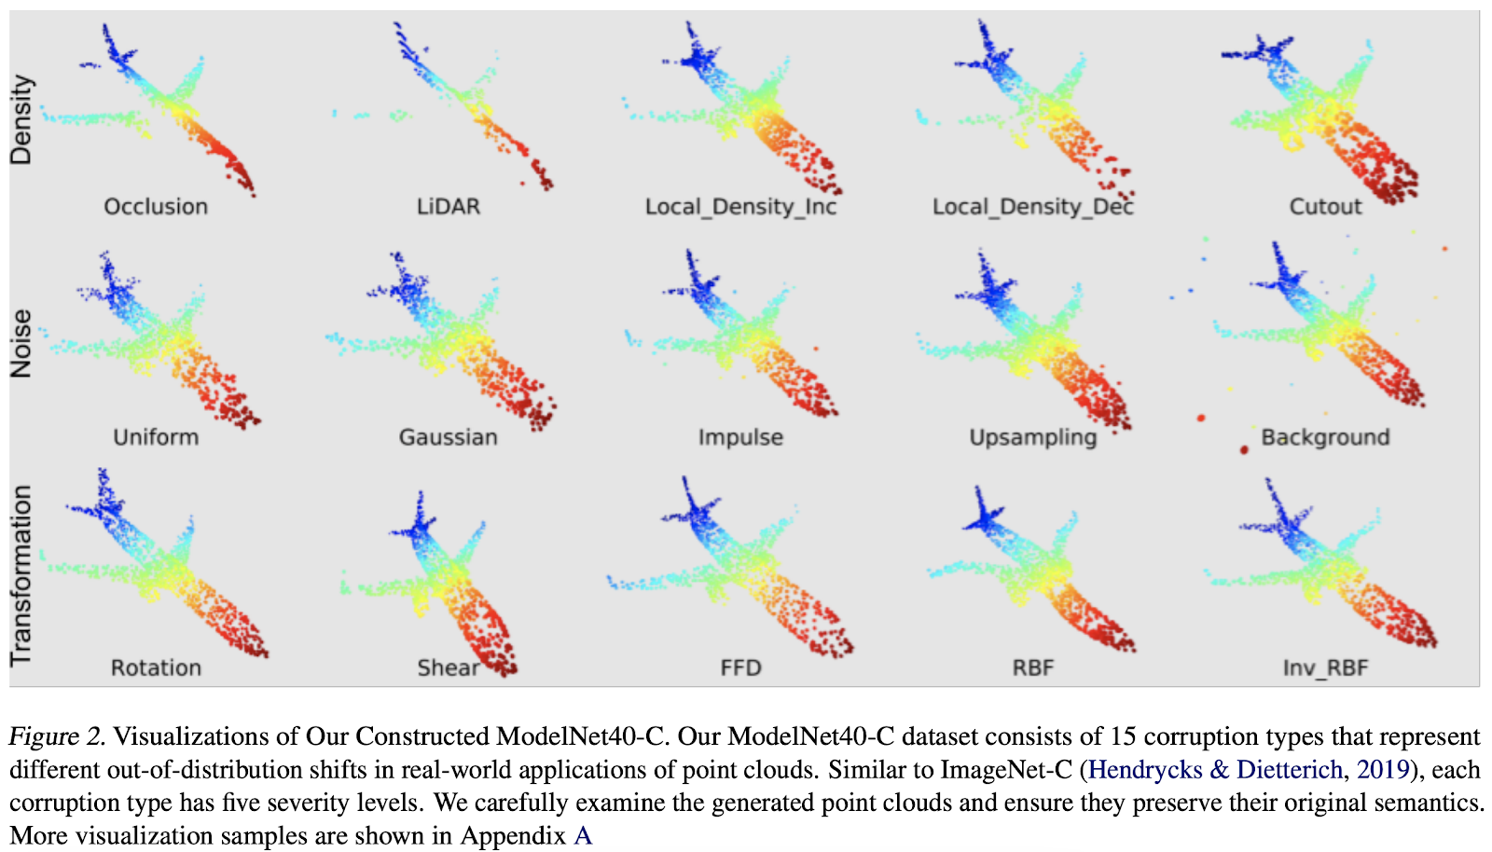
ModelNet40-C

Slide 15
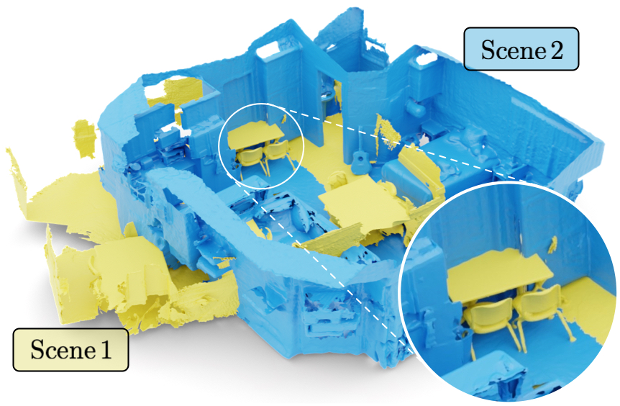
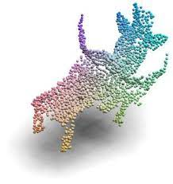
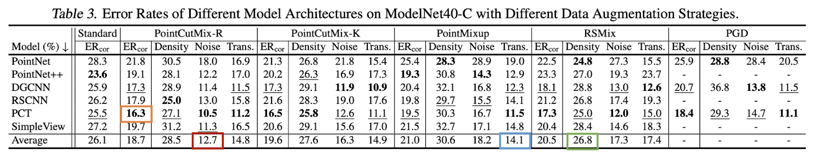
Project
Find point cloud augmentation methods for robust point cloud perception

Slide 16
Thank you ☺ Presenter: Nahyuk Lee

